Slide 1
GEE Phenology
June 6, 2018

Slide 2
Phenology from Satellite Data

Slide 3
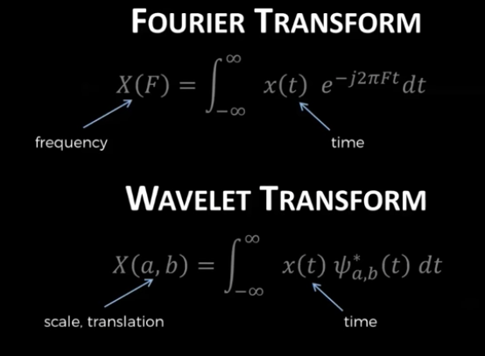
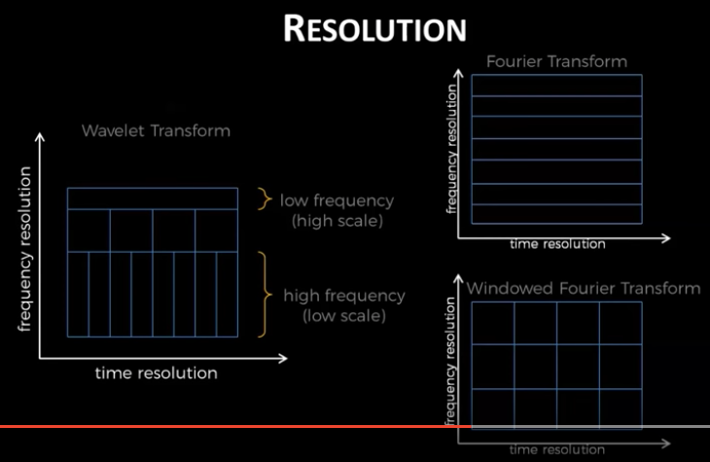
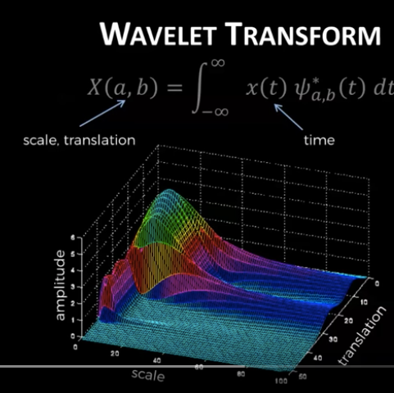
Wavelet transform background info
Good wavelet introductions:
https://www.youtube.com/watch?v=QX1-xGVFqmw
https://www.youtube.com/watch?v=ZnmvUCtUAEE
Translation: shifting in time
Scale: shifting in frequency (high scale = low frequency)
Heisenberg principle:
Area of the heisenberg boxes must be equal.
Can’t be very accurate in location and time, AND also location and frequency
Wavelet transform, unlike fourier, can detect localized signals amid noise (localized in time). Fourier transform, which uses sin waves that oscillate forever, isn’t localized in the time domain. Wavelets exist for finite time only, doesn’t go onto infinity

Slide 4
Planting and harvest date estimation from satellite data
Paper | (Sakamoto et al, 2005)*** | (Whitcraft et al, 2014)
Plant | Paddy rice | General agri at 0.5 degrees (phenology transitions of all rotations)
Satellite and VI | MODIS, EVI | MODIS 250m, NDVI
Method | Smoothed EVI timseries using Coiflet filter, order = 4, to get max, min, inflection point | Threshold
Errors | 12.1 days for planting 10.6 days for harvest | Couldn’t validate b/c they did a global study
Code avail? | ‘wavelets’ package in R | Not hard to write, BUT need to figure out how to find the threshold
Details for det. phenology | Planting date: from the “max” NDVI, walk back at least 60 days; then, find either min or the inflection pt; the later of these two is planting. Harvest date: inflection point later than 30 days after the “max” NDVI | Start of season: when upsloping NDVI surpasses a certain threshold in a period preceding an annual max NDVI (greenup) End of season is the point at which a downsloping NDVI drops below a threshold in the period following the NDVI peak Thresholds were determined iteratively…. How can we find it? Removed outliers in SOS and EOS by ID central tendency and remove dates that fell more than one median absolute deviation from the median
Notes | The number of elements in input data should be a power of 2, recursively filled the array of 2048 elements, interpolated missing data. Determined frequency of growing period and selected that frequency component. See paper for details on processing. | Even though it was developed for a mix of agri plants, maybe we can use a similar method for soybean only? They replaced missing data gaps by linear interpolation Make sure MODIS data is “cleaned” – atmospheric correction, etc They DO NOT have planting date; only greenup date Double cropping can mess up the “averaged” SOS and EOS – maybe not a problem for us because we hopefully won’t have huge mixed pixels. Make sure the threshold and smoothing timeseries takes into account potential double cropping though.

Slide 5

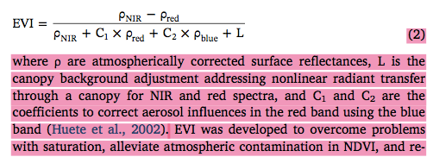
Planting and harvest date estimation from satellite data
Paper | (Urban et al, 2018)***
Plant | Soybean | Soybean
Satellite and VI | MODIS EVI | MODIS EVI
Method | Inflection point: the inflection point of the first derivative of the fitted curve for the green-up period. | Threshold (10%, 20%, 30%, 50%) between the min and max value in a logistic-curve smoothed phenology
Errors | RMSE = 9 days, correlation = 0.75 | RMSE = 5 days, correlation = 0.75
Code avail? | See the papers they cited | See the papers they cited
Details for det. phenology | Fitted to double logistic function as in (Guan et al, 2014) – fitted using trust-region reflective algorithm | Same – double logistic function was fitted
Notes | Only for planting date! EVI from the MODIS MOD13C1 (Collection 6) (Solano et al., 2010), which is a 16-day composite, 0.05-degree, global product from 2000 to the present. Data with only “Good” in the QA were used in this study. The 16-day raw data were further interpolated and gap-filled using a robust smoothing algorithm based on discrete cosine transform (DCT) Bias correcting for temperature improves performance because high T will accelerate phenology (faster greenup) | Only for planting date! 30% threshold is the best for min RMSE and reproducing interannual variability The inflection method and 30% threshold method are best for RMSE. For EVI, 30% threshold gives both the lowest RMSE and
(Reed et al, 2009) – ready to use EVI

Slide 6
Planting and harvest date estimation from satellite data
Paper | (Sakamoto et al, 2010)
Plant | Soybean (and maize)
Satellite and VI | MODIS WDRVI, 250m 250 m and 500 m MODIS surface reflectance data (MOD09Q1 and MOD09A1, Collection 5)
Method | Two-step filtering (TSF) [basically adds some a priori info about crop growth patterns]
Errors | RMSE of 3 to 7 days
Code avail?
Details for det. phenology | Smooth WDRVI with wavelet-based filter (coiflet, order = 4) to get rid of high freq noise. Linear interpolation for missing data. (Sakamoto et al, 2005) has details on smoothing. Derive optimum scaling parameters from shape-model fitting procedure (Generalized Reduced Gradient Code). The shape model is specific to WDRVI and the crop – shape model is generated by multi year smoothed WDRVI profile (so it’s NOT mathematically defined logistic, double logistic fcn, etc) Estimate phenology stages from optimum scaling parameters and a preliminarily defined phenology date from ground based observations
Notes | Seems complicated, and we prob don’t have good ground based observations. The paper says that because soybean’s phenology curve is simple (unimodel, symmetrical), don’t need a complicated method like shape model fitting. However, it’s always nice to have a shape model representing macroscopic features in the timeseries rather an relying on localized features in the timeseries. They detected: early veg stage, beginning seed, full seed, and beginning maturity (so NOT planting and harvest…)

Slide 7
Planting and harvest date estimation from satellite data
Paper | (Gao et al, 2017)** | (Zhang et al, 2003)**
Plant | Soybean (and maize) | Any
Satellite and VI | Landsat-MODIS fusion (we can just do either MODIS or Landsat), NDVI | MODIS, EVI (1 km)
Method | Inflection point gets greenup and dormancy Green up from RS happened 1-3 weeks after ground observed emergence Harvest happened 1-2 weeks after dormancy stage was detected by RS | Piecewise logistic function was fitted to EVI timeseries, then inflection points indicate greenup and dormancy
Errors | Not sure | Wasn’t validated, but has been used a lot since then
Code avail? | TIMESAT program from (Jonsson and Eklundh, 2004) | Equations look easy to apply
Details for det. phenology | Two ways: Used TIMESAT (which smoothes NDVI data, fits it to asymmetric Gaussians, double logistic or Savitzky-Golay filters). Then, the star tand end of season were defined by thresholds (max – min base value) in NDVI. (need to get thresholds for soybean – the paper suggested 15% for greenup) MODIS phenology algorithm by (Zhang et al, 2003) – piecewise logistic fitting function, then use curvature to define phenology Found that MODIS curvature approach was better at producing greenup dates | Fitted a piecewise logistic function to MODIS EVI data Piecewise part: cycles of increasing/decreasing EVI were found with a moving window average.
Notes | Doesn’t explicitly do planting and harvest, but suggests lags to get from phenology to planting/harvest They “padded” a single year of data into two years by inserting second half of the year before the start of the “focus” year, and the first half of the year after the “focus” year to construct timeseries functions | This is the “MODIS curvature approach” in (Gao et al, 2017) Supports double cropping because it’s piecewise! Perhaps add in the lag to get planting and harvest date?

Slide 8
Planting and harvest date estimation from satellite data
Paper | (Jonsson and Eklundh, 2004) | (Guan et al, 2014)*
Plant | none | General vegetation (not crop)
Satellite and VI | AVHRR NDVI | SEVIRI, daily LAI
Method | TIMESAT | Fit LAI to double-logistic curve, then use fitted parameters to get phenology information (i.e. start, end of growing season)
Errors | n/a | No specific mention of validation
Code avail? | TIMESAT in fortran, MATLB… | Shouldn’t be hard to find logistic regression; then, paper has equations to get to SOS, EOS
Details for det. phenology | Not about phenology | Not about crops They had daily LAI, didn’t have to do interpolation Used trust-region-reflective algorithm to fit daily LAI to logistic function
Notes | This is the TIMESAT approach mentioned by (Gao et al, 2017) General timeseries fitting approaches – not about phenology | They have a potentially useful way (using Fourier spectrum frequency power) to determine whether a pixel has a single or double growing season

Slide 9
Planting and harvest date estimation from satellite data
Paper | (Galford et al, 2008)***
Plant | All crops
Satellite and VI | MODIS EVI (MOD09 (V004) 9day 500m)
Method | Wavelet-smoothed time series to get phenology, following (Sakamoto et al, 2005) – 90% power wavelet transform
Errors | Their errors were in terms of land use, not phenological dates
Code avail? | Use R?
Details for det. phenology | Just did smoothing with wavelet and determined whether a pixel was single or double cropped based on peak number
Notes | This was for land use change detection. Follow their data cleaning technique. Can use their “peak counting” method to separate single vs double cropping.

Slide 10
Phenology from satellite data: Plan
(Sakamoto et al, 2005)
WFCP method
(Urban et al, 2018)
(Zhang et al, 2003)
MODIS/Terra SR 8-day Global 500m V004 (lowest value of band 3 over every 8 days and corrected for gas and aerosol scattering)
EVI
MODIS, daily, cloud-free-atmospherically corrected, 1km, 16-day periods
EVI
Data/
Index
MODIS, MOD13CI (Collection 6) 16 day composite, 0.05 deg
EVI
Data Cleaning
Clouds: remove pixel whose band 3 reflectance > 10%
Low res pixels: remove pixels with sensor zenith angle larger than 32.25 deg
Make array with 2048 elements by continuously and recursively filling array
Linearly interpolate missing data
Use the 365 elements of the output array from the 730th to 1094th as smoothed time profile of EVI
Used only data with “Good” in QA
Interpolated 16-day raw data
Gap-filled data with smoothing algorithm based on discrete cosine transform
Used NBAR data (nadir BRDF-adjusted reflectance)
Single/Double crop
No mention; replace with methods from other papers
No mention; replace with methods from other papers
ID periods of sustained EVI inc/dec by using 5 moving 16 day windows, identify when slope changes within a window

Slide 11
Phenology from satellite data: Plan
(Gao et al, 2017)
(Guan et al, 2014)
(Galford et al, 2008)
Data/
Index
MODIS daily SR, 250m
MODIS BRDF, 16 day, 500m
MODIS Collection 5
NDVI
MOD09 (V004) 8 day, 500m SR composites
EVI
Clouds: band 3 reflectance > 10%
Get rid of noise: where exceed 0.15 change threshold in EVI from value at prev timestep
Replace missing values w/ linear interpolation to produce daily timestep EVI to avoid aliasing effect during wavelet analysis
Resample daily interpolated data to 7 day intervals to decrease size and processing time
“Condition” the wavelet by replicating first and last yrs of data
Data Cleaning
Used MODIS BRDF and MODIS daily SR to do BRDF correction, to get MODIS daily NBAR 250m
NBAR = nadir NRDF-adjusted reflectance
Padded timeseries for fitting: a “focus” year in the center of two ½ years before and after
Use Fourier to classify single vs double crop (using daily LAI)
Fourier spectrum power @ 6 months > 0.35 means double Fourier spectrum power @ 12 months > 0.7 means single
Both true means transitional
Neither true means no seasonality
Detect single vs double cropping using # maxima in wavelet-smoothed EVI
Remove false peaks at start of season by using 0.4 EVI threshold for 90% power wavelet (usually it’s weeds at start of rainy season)
Single/Double crop
Piecewise logistic from (Zhang et al, 2003)

Slide 12
Phenology from satellite data: Plan
(Sakamoto et al, 2005)
WFCP method
(Urban et al, 2018)
(Zhang et al, 2003)
Smoothing
Coiflet 4 wavelet smoothing
Choose specific frequency components using knowledge of growing period =90-160days:
Freq lower than 128 = 2^7 is seasonal change
Freq higher than 64 = 2^6 is reduced as noise
Freq lower than scale 32 = 2^5 should be used to ID abrupt change in date around plant and harvest
Avg two time profiles to get smoothed EVI:
Lower freq components divided by scale 64
Lower freq components divided by scale 32
Double logistic fcn like (Zhang et al, 2003)
Fitted using trust-region reflective algorithm
Fit logistic fcn to each period of EVI increase or decrease
Phenology
Greenup and dormancy are at inflection points
Use phenology (greenup, dormancy) to get a “sanity check” or range on planting/harvest dates calculated here
Planting/Harvest
Planting: (for rice)
Estimate date of peak EVI
Find min and inflection earlier than 60 days from peak EVI date
The later one is planting date
Harvest: inflection later than 30 days after peak EVI
Planting (for soybean):
When 30% of green-up period range using fitted curve is reached
How to define green-up period?
Adjust by 1-3 weeks?

Slide 13
Phenology from satellite data: Plan
(Gao et al, 2017)
(Guan et al, 2014)
(Galford et al, 2008)
Smoothing
Piecewise logistic
Zhang et al, 2003’s fitting method
Multiple logistic curves
Fit using trust-region-reflective algorithm
Paper has detailed eqns for the parameters to fit in single and double cropped cases
Coiflet order 4
At 90% power wavelet (ok for single and double cropping) – a variant of Sakomoto et al, 2005’s multiple freq thresholds to remove noise, except this doesn’t require assuming length of growing season
Phenology
Probably inflection points
Greenon, dormancy come from equations that use the fitted params of the logistic curves
Different equations for single vs double cropped
Planting/Harvest
For soybeans:
Greenup + 1 to 3 weeks = emergence
Dormancy – 1 to 2 weeks = harvest
Adjust by 1-3 weeks?

Slide 14
Phenology from satellite data
Data for EVI
MODIS, corrected for cloud, aerosol/gas scattering, NBAR (off-nadir), data with “Good” in QA
Data Cleaning
Wavelet:
Linearly interpolate EVI to get daily timeseries (to avoid aliasing effect for wavelet analysis)
(Sakamoto et al, 2005)
Logistic:
Linearly interpolate EVI to replace missing data
Crop Rotations
Wavelet:
Detect number of peaks in wavelet-smoothed EVI (above some EVI threshold)
(Galford et al, 2008)
Logistic:
Identify periods of EVI increase/decrease using moving 16-day windows
(Zhang et al, 2003)
Smoothing
Wavelet:
Coiflet 4 wavelet with 90% power to remove noise
“Condition” timeseries by padding beginning, end
(Galford et al, 2008)
Logistic:
Piecewise logistic function
Fit with trust-region-reflective algorithm
(Urban et al, 2018)
Planting/Harvest Date
Wavelet:
Planting date = min or inflection pt at least 60 days before peak EVI (paddy rice)
Harvest date = inflection pt more than 30 days after peak EVI (paddy rice)
Error ~ 10 days
(Sakamoto et al, 2005)
Logistic:
Planting date = 30% threshold of greenup EVI range (error ~ 5 days)
Planting date = emergence + x days; emergence = 1-3 weeks before inflection point
Harvest date = 1-2 weeks after dormancy, which is inflection point
(Gao et al, 2017)

Slide 15
Finding LAI from vegetation indices

Slide 16
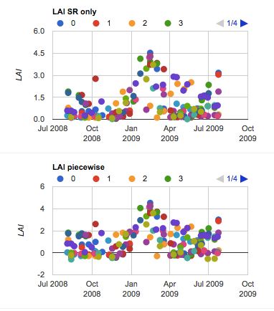
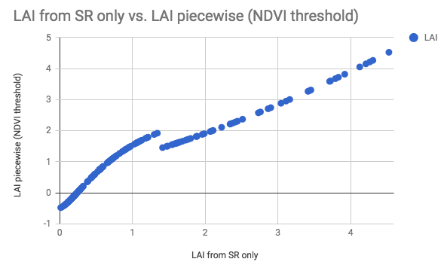
Lit Review: Vegetation index -> LAI options for soybean
(Nguy-Robertson et al, 2012)
Option 1. piecewise (NDVI threshold)
Below NDVI = 0.7, gLAI = (NDVI – 0.27)/0.22
Above NDVI = 0.7, gLAI = (SR + 3.2)/6.2
Option 2. “SR only”
gLAI = [(SR – 1.39)^0.698]/2

Slide 17
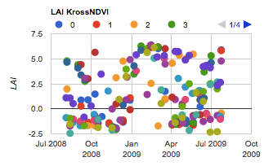
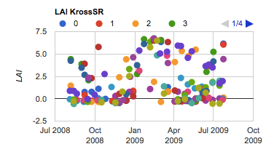
Lit Review: Vegetation index -> LAI options for soybean
(Nguy-Robertson et al, 2012)
Option 3.
gLAI = log_base0.37(NDVI^-0.526 – 1.03)
(Kross et al, 2015)
Option 4. “Kross NDVI”
LAI = 11.266*NDVI – 4.007
Option 5. “KrossSR”
LAI = 9.296*(-exp(-0.163*SR)) + 6.910
NDVI = (NIR – red)/(NIR + red)
SR = NIR/red

Slide 18
Landsat LAI Timeseries

Slide 19
GEE: Landsat Phenology, Landsat Phenology v2, Landsat Phenology v3
Reading in csv of rally points: took subset of rally points because of computation space. It seems to read in lat and long, so in the rallypoints_subset.csv, physically switched the column order and labeled “y” as lat and “x” as long.
Renamed the “year” column to “blah” to be able to filter out points by year
Work with “rallypoints_subset” or “rallypoints_full”, which have the lat/long and “blah” edits

Slide 20
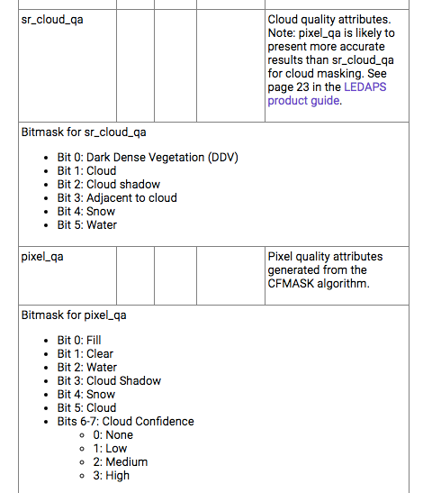
Masking out clouds using pixel_qa band
Landsat 7 cloud bands:
https://code.earthengine.google.com/dataset/LANDSAT/LE07/C01/T1_SR
Tutorial on masking clouds in Landsat 8:
https://geohackweek.github.io/GoogleEarthEngine/03-load-imagery/

Slide 21
In GEE: MODIS Phenology
(Sakamoto et al, 2010)
In MODIS data, any pixel with blue band above 0.2 was considered a cloud covered pixel

Slide 22
Tasks
DUE June 11: Mask of single/double cropped areas – pick the Morgen class for the Rally pixels so Gabriel can see how they relate to onset-greenup
DUE June 11: Phenology curves of soy pixels with MODIS
DUE June 13: Soy classification maps: Obtain all relevant soymaps and decide on combining maps if necessary. overlay Pequisa agri municipal data as a “check”
DUE June 13: Determine representativeness of yield data
DUE June 18: Sample new soy pixels
DUE June 25: Phenology calculations (planting, harvest estimates) for all sampled soy pixels
To Do
LAI example points using MODIS
Use LAI, not gLAI
Look at WDRVI in rally points for an idea of phenology.
For calculating vegetation indices, and making sure clouds aren’t in it
Finding planting date and harvest from phenology: look at how feasible it is. Try it in GEE, look at timeseries tutorial.
Put in GEE a way to get a sense of the spread in planting, harvest dates and how different pixels look from each other.
Ask Avery or Gabriel:
For the single vs double cropping data: ask Avery if this data represents the farmers’ intention vs what they actually did.
Is there any sort of ground truth planting date for validation?
Notes:
All weather data will be interpolated (Tmin, Tmax, Tavg, wind speed, specific humidity, precip, radiation); interpolation will happen during the process of going from pixel to list
Classify pixels into region in the native weather data grid
Ask Dave – what does he do for gridded weather? What dataset does he use? Does he interpolate?
My work:
Bottleneck: Ask about datasets. Ask about cyberinfrastructure. Need: onset, Rally da Safra, LC Morgen soymap, Mapbiomas, other land use classifications, single vs double crop maps
Compile soymap and yield data
Determine rep of yield data
Select new soy pixels if necessary
Tie LAI info to the selected and yield soy pixels

